Slide 1
Project Meeting
2018/8/30

Slide 2
Progress
Architecture
IoT device platform survey
About compatibility between ARM Mbed OS & Raspberry Pi

Slide 3

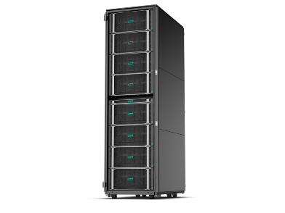
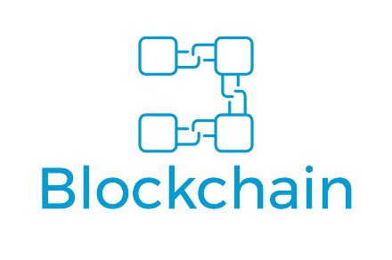


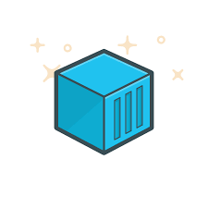
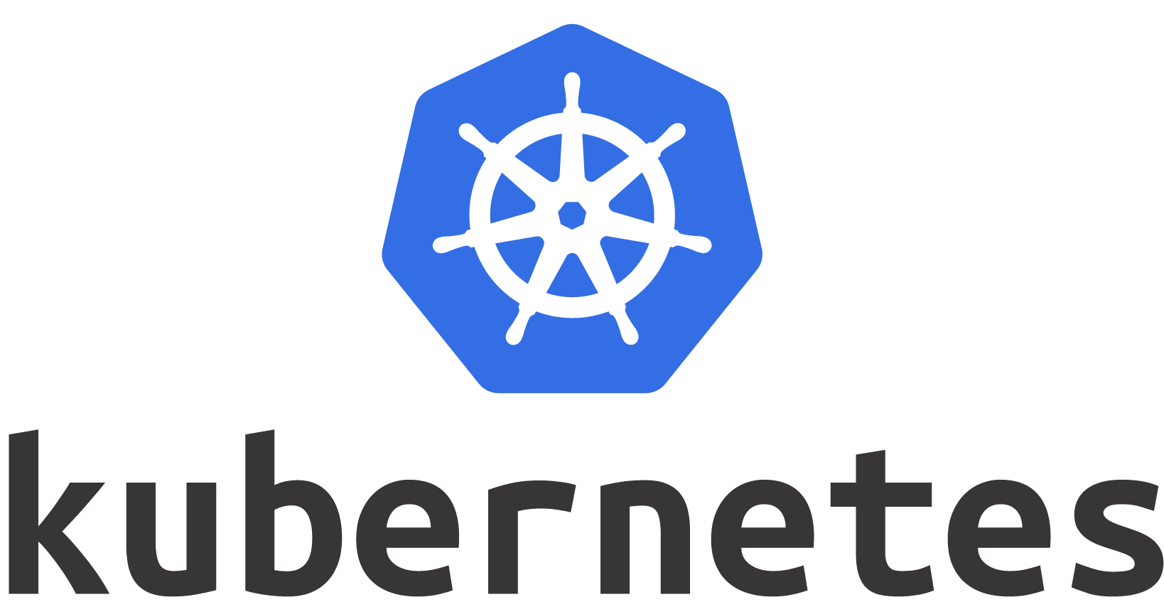
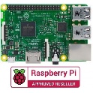



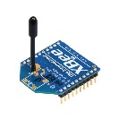

Architecture
Cloud server
Cloud Layer
node
node
Fog Layer
node
node
node
Sensor Layer
device
device
device
device
device
device

Slide 4
IoT device platform
Popular IoT Platform:
IBM Blue mix
Microsoft Azure IoT Suite
Amazon AWS
MTK Cloud Sandbox (MCS)
ThingSpeak (open source)
Advantech WebAccess
Thinger.io (open source)

Slide 5




Thingspeak
Features:
Opensource
Send sensor data privately to the cloud
Analyze and visualize your data with MATLAB
Trigger a reaction
Works With
Arduino®
Raspberry Pi™

Slide 6
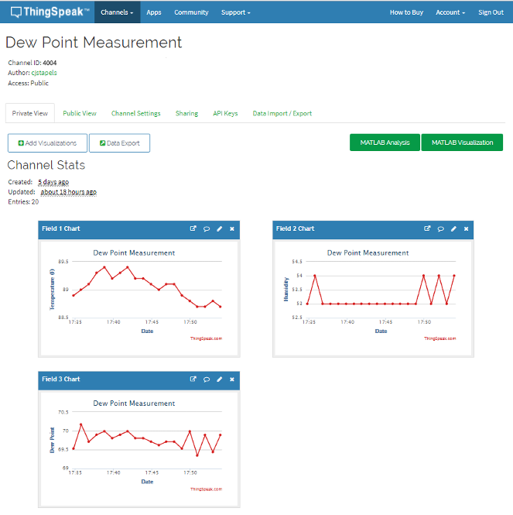
Platform dashboard

Slide 7
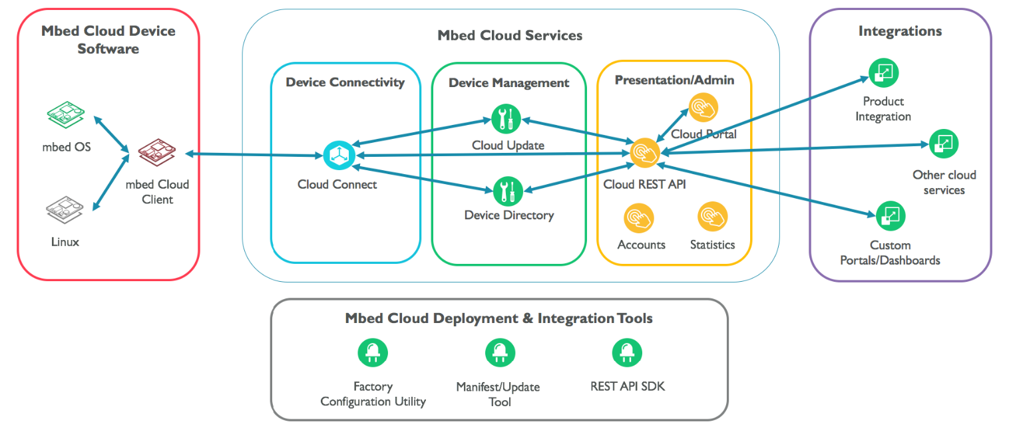
Compatibility
Raspberry Pi can connect to ARM Mbed clouds
Mbed clouds: a secure connection, over which you can interact and manage your IoT devices
Raspberry Pi can not use ARM’s Mbed OS

